Slide 1
Cryptocurrency Social Sentiment Analysis
Presenter: Cong Chen, Mike Wu, Irene Chang, Boran Chen
Mar 24th, 2018
Notes:
Good evening, everyone! This is Digital Lab Group presenting. My name is Boran Chen, There is our team of developers, Cong Chen, Mike Wu, and Irene Chang. Our project is called cryptocurrency social sentiment analysis.

Slide 2
OUR GOAL
We are testing whether there is correlation between cryptocurrency price and social media sentiments on Twitter, and if there is, how they are related.

Slide 3
Workflow
How we do our data analysis.
Project
Analysis Process
Data
Gathering
Data
Cleaning
Data
Merging
Data
Visualization
Insights!
Step. 1
Step. 2
Step. 3
Step. 4
Step. 5

Slide 4


Major Tools We Used
Twitter
API
Matplotlib
Data
Insight
Pandas
With all the process, we finally
got our story
Data Gathering
Data Cleaning & Merging
Data Visualization
Here is our story

Slide 5
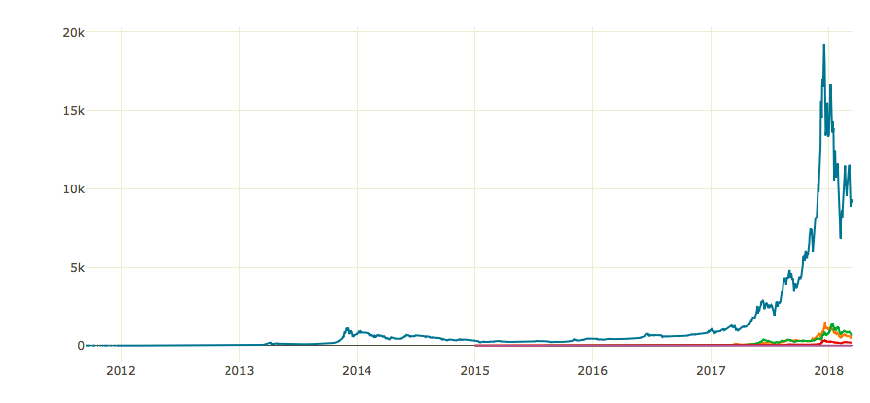
Bitcoin & Crypoto Trend

Slide 6
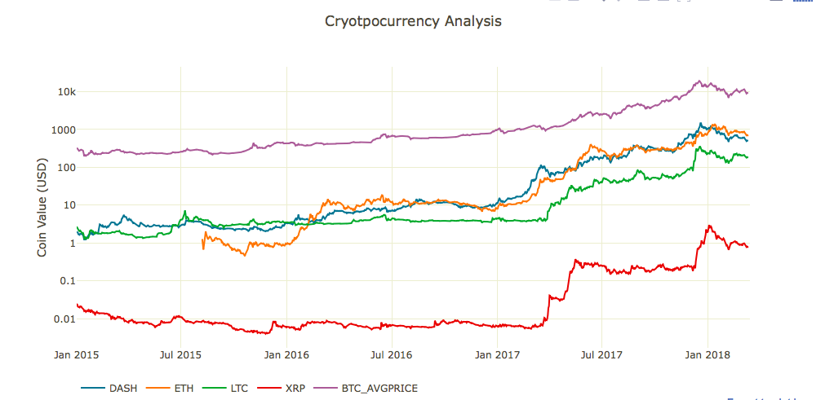
Crypto Market Trend

Slide 7
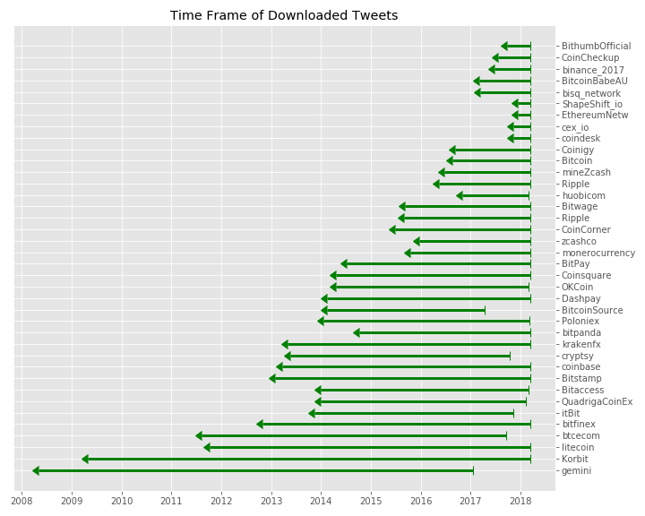
Time Frame of Data Source

Slide 8
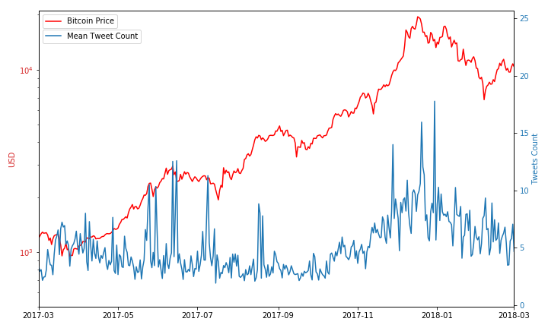
Tweets counts is positively correlated to Bitcoin Price

Slide 9
Further Analysis

Slide 10
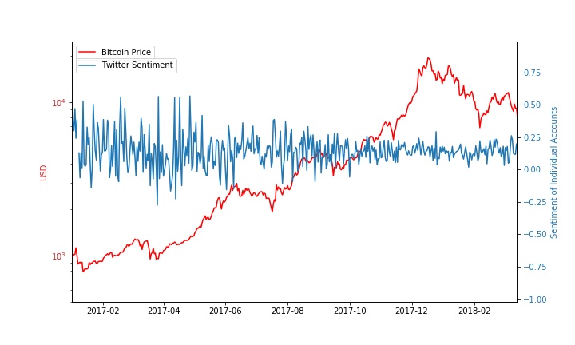
Bitcoin Price V.S Twitter Sentiment 2017/01/01-2018/03/15, 30 Representative Individual Accounts
Criteria:
Followers > 500K
VIPs, founders, analysts, investors, or miners

Slide 11
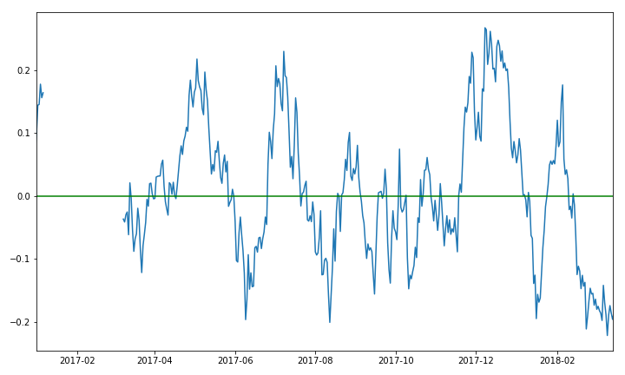
No Obvious Correlation between Bitcoin Price and Twitter Sentiment
2017/01/01-2018/03/15, Representative 30 Individual Accounts

Slide 12
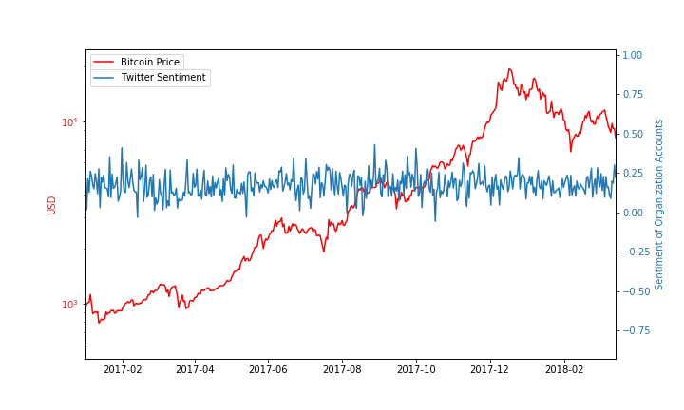
Bitcoin Price V.S Tweeter Sentiment 2017/01/01-2018/03/15, 42 Organization Accounts
Notes:
Similarly ,we compare the price

Slide 13
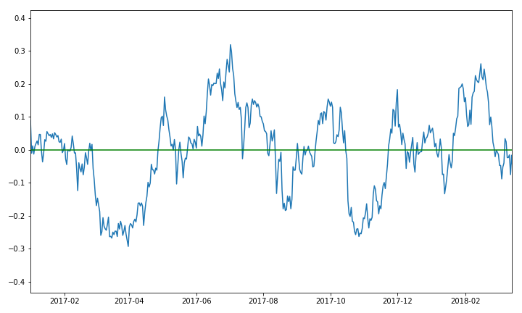
No Obvious Correlation between Bitcoin Price and Twitter Sentiment
2017/01/01-2018/03/15, 42 Organization Accounts

Slide 14
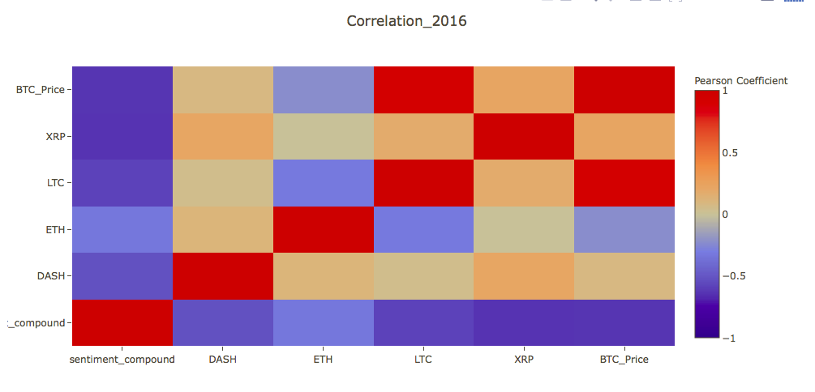
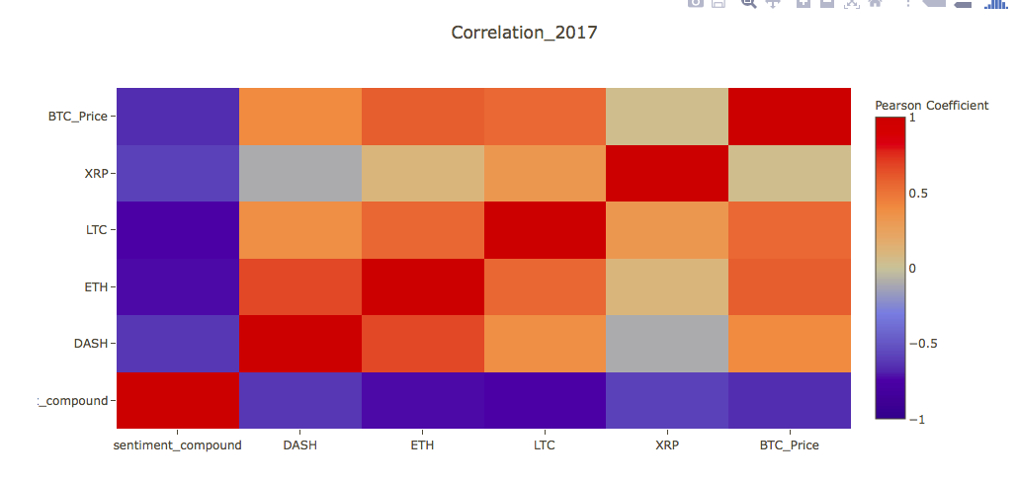
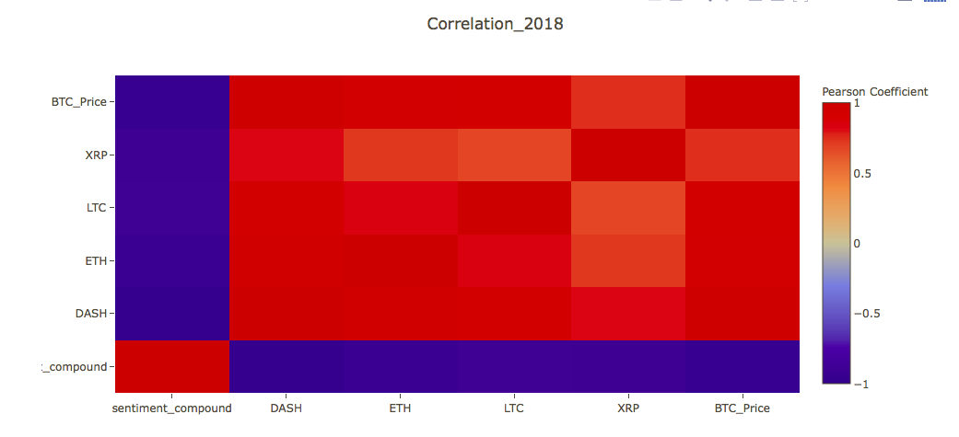
2016 vs 2017 vs 2018 Correlation
2016
2017
2018
BTC
XRP
LTC
ETH
DASH
Com-
pound
Compound DASH ETH LTC XRP BTC
Compound DASH ETH LTC XRP BTC
Compound DASH ETH LTC XRP BTC
The correlation among cryptocurrencies INCREASES POSITIVELY
The correlation between sentiment & cryptocurrencies INCREASES NEGATIVELY

Slide 15
Possible Reasons
More twitter and social media data might be required
Social media reactions may be later than real crypto market movement
Trading behaviour, real influencer usually does that opposite than public sentiments

Slide 16
Future Direction
Wider Scope of Social Media
Key Word Search
Longer Follow-Up Period e.g 2018 full year
further question: whether we could analyze the sensitivities for coins with more significant monetary volumes reaction to social media sentiments vs sensitivities of coins with less significant monetary volumes reactions to social media sentiments
Notes:
If we have more capacity and time, we will explore following points.
More languages , more different platforms of social media
try keyword search

Slide 17
THANK YOU FOR YOUR ATTENTION
Presenter: Cong Chen, Mike Wu, Irene Chang, Boran Chen
Mar 24th, 2018

Slide 18
Q&A

Slide 19
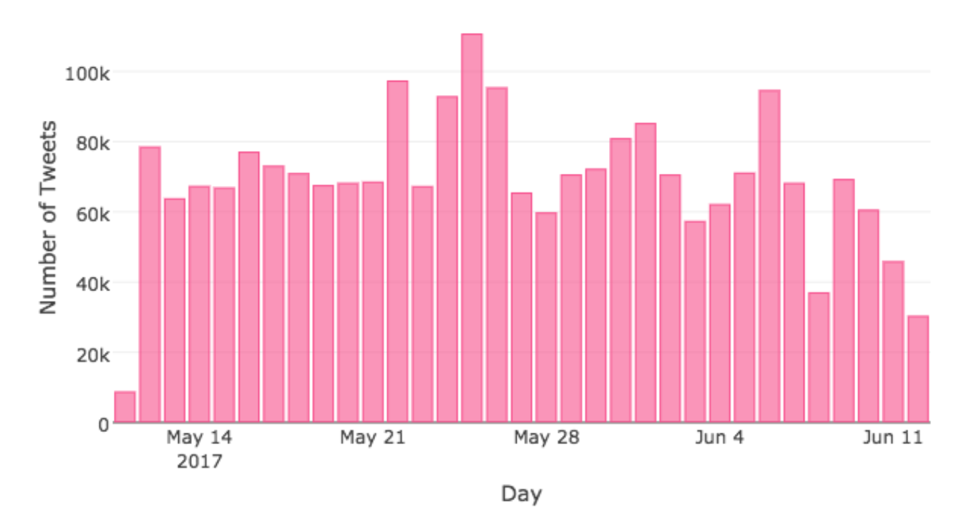
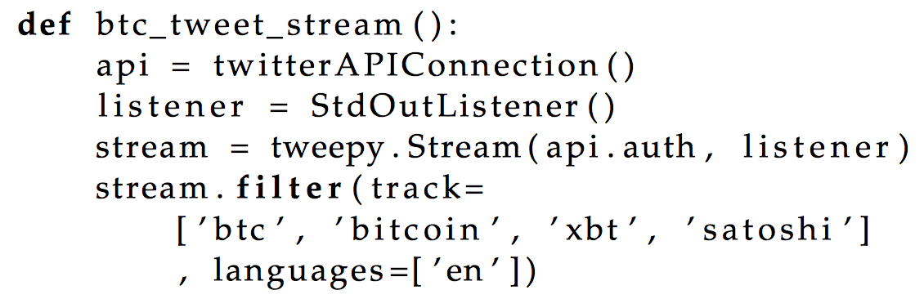

Slide 20
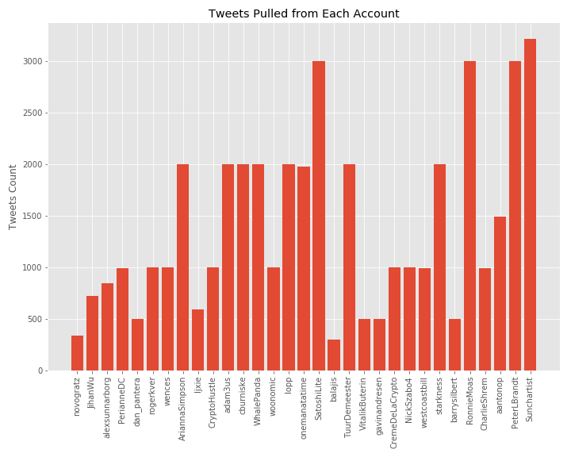
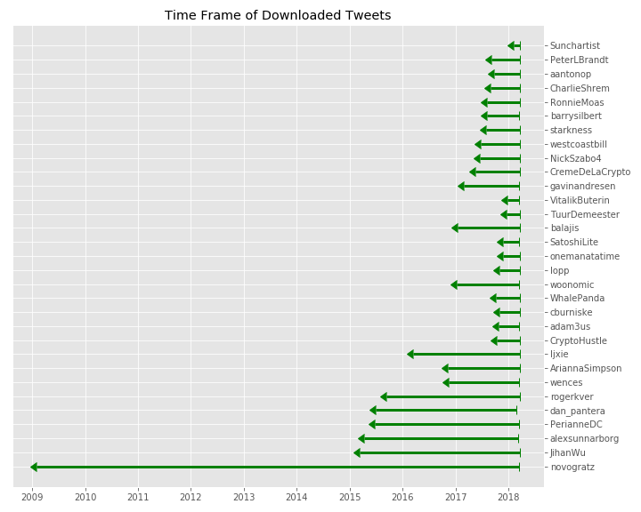
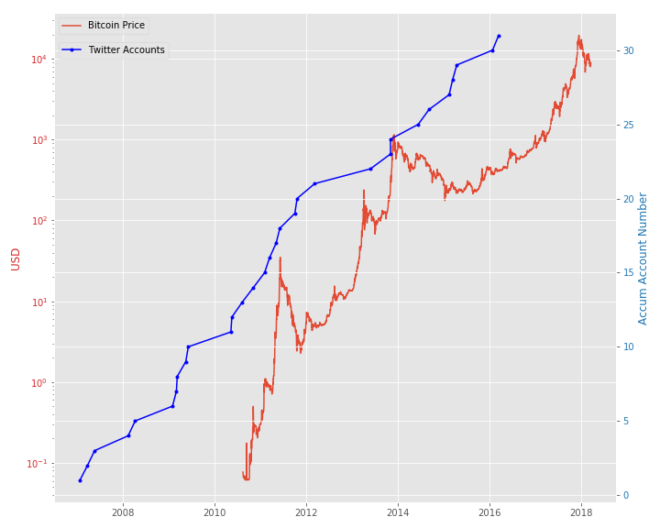
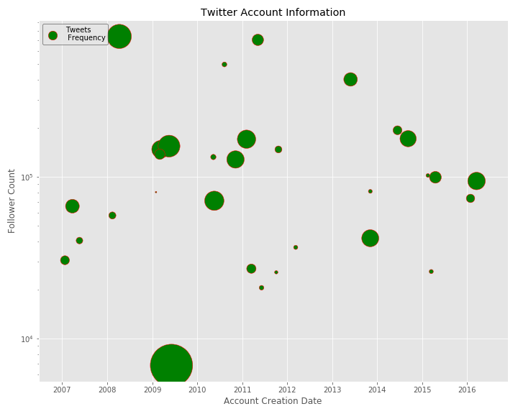
Accumulated Account no. is positively correlated to Bitcoin Price
from 2008-2018, 30 individual accounts

Slide 21
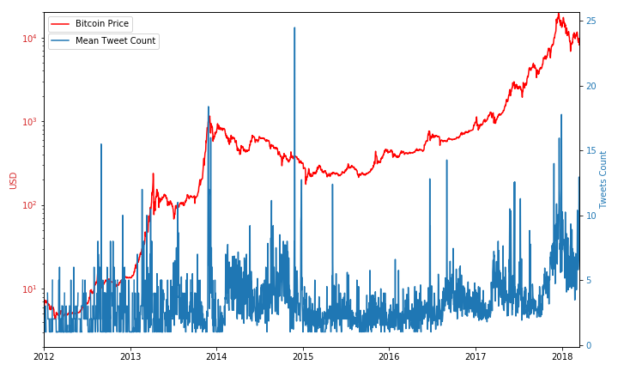
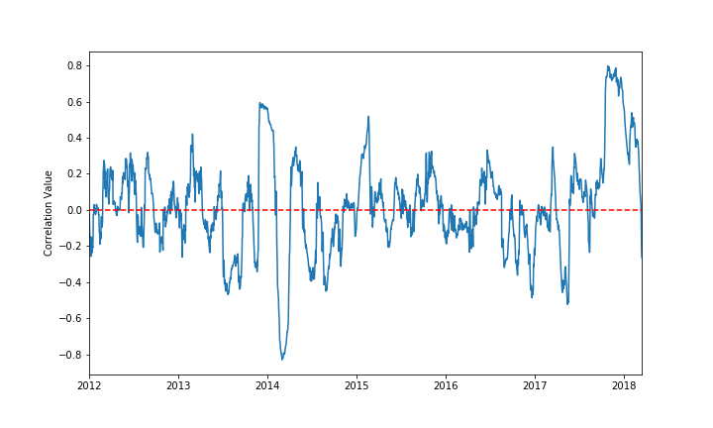
Analyze Exchange Accounts:
Tweets count 01

Slide 22
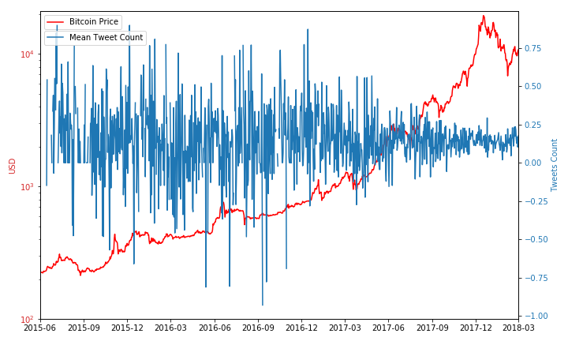
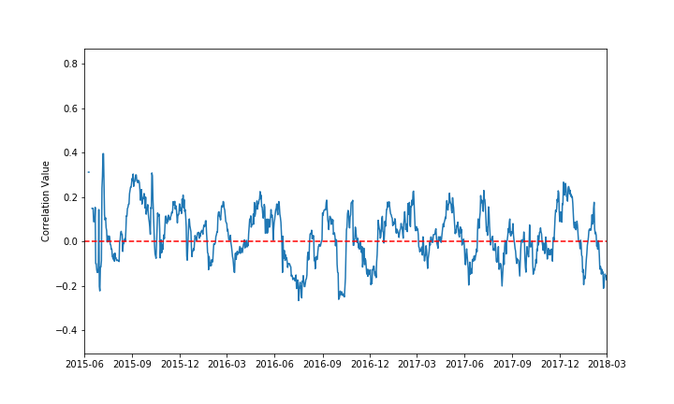
Analyze Individual Accounts:
Sentiment 01

Slide 23
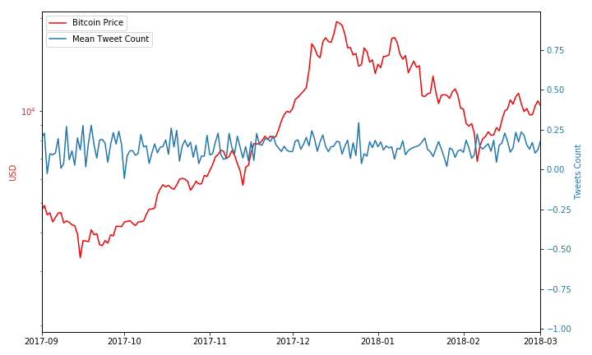
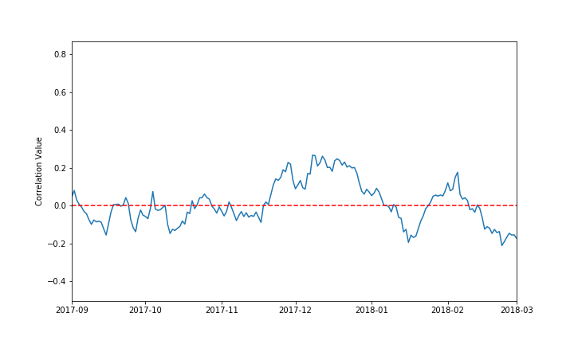
Analyze Individual Accounts:
Sentiment 02

Slide 24
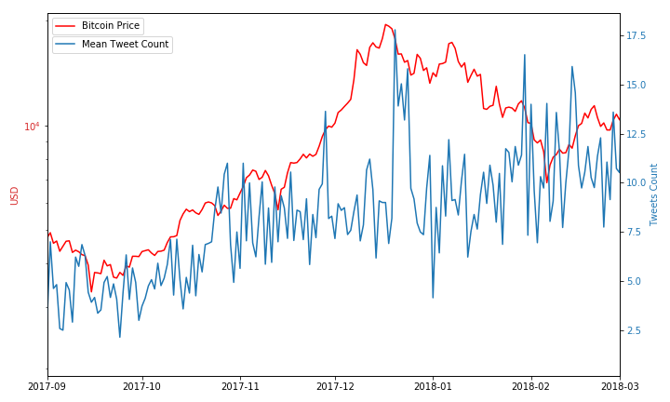
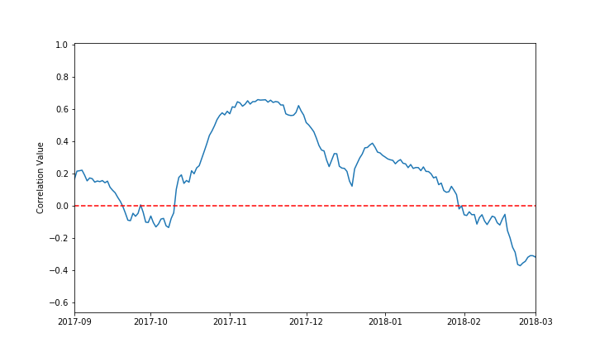
Analyze Individual Accounts:
Tweet count 01

Slide 25
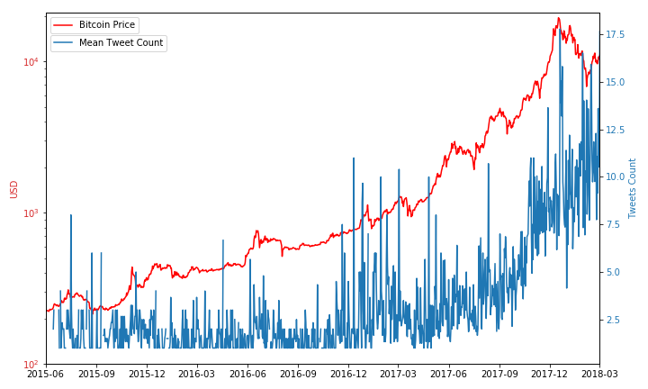
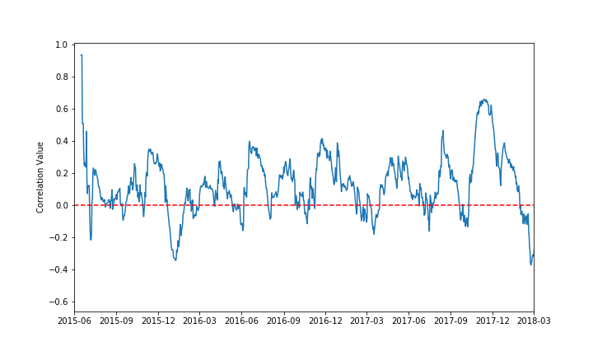
Analyze Individual Accounts:
Tweet count 02

Slide 26
